Slide 1
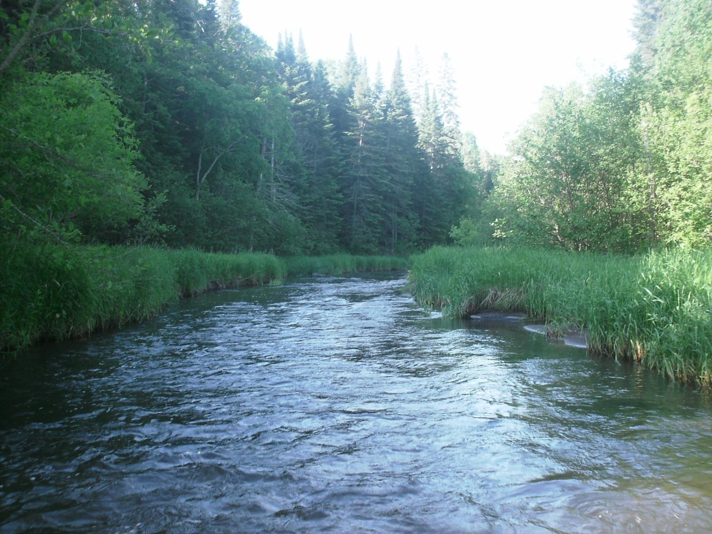
Legislative Water Commission
July 26
Co-chairs: Senator Wiger Representative Torkelson
Jim Stark, Director
Straight River, Becker County
1

Slide 2
Legislative Water Commission
Thursday, July 26, 2018 (10 am)
State Office Building: Room 10
Rep. Paul Torkelson, Chair Sen. Chuck Wiger, Co-Chair
Agenda
Approval of minutes April and June
Discussion: One Water Summit Meeting
Water Issues Presentations:
Minnesota Groundwater Association White Paper on Agricultural Drainage Ellen Considine ( DNR)
Chloride in Minnesota’s waters ( Andy Erickson/Ben Janke (UM)) (40 minutes)
Review of Clean Water Fund Meeting - Jim Stark
2019 LWC Recommendations and Process-Jim Stark
Future meeting discussion
Adjourn at 11:30
2

Slide 3
One Water Summit: Senator Wiger
3

Slide 4
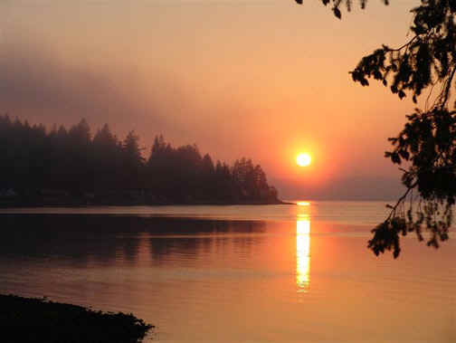
Water Issue Presentations
Chlorides in Water
( Andy Erickson/ Ben Janke (UM))
Drain Tile/ Groundwater White Paper
( Ellen Considine (MN GW Association))
Notes:
For more information and real time monitoring data you can visit this web site.

Slide 5
2019 Legislative Stakeholder Process
Notes:
For more information and real time monitoring data you can visit this web site.

Slide 6
2019 Recommendation Process
Six Issues/Five Stakeholder meetings At each meeting:
Discuss the Individual Issue and Recommendations, based on:
2018 session process
LWC guidance
Stakeholder advice
Review of many plans/documents

Slide 7
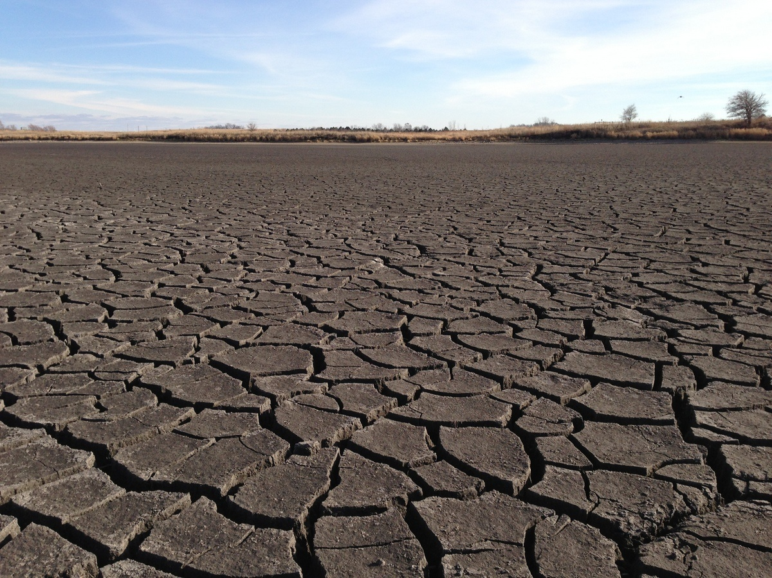
A Firm Foundation
1989- GW Act
1999- USGS Sustainability Report
2004- G16 Impaired Waters Plan (MPCA)
2005- DNR/GW Report
2006- Clean Water Legacy Act
2006- ENRTF Sustainability Report
2008- Clean Water Amendment
2008 Legislative Water Sustainability Framework
2009- EQB Sustainability Report
2012- GW Management Area Plans (DNR)
2017- Freshwater Society Reports on Water Sustainability
(Worthington, MN-2012)

Slide 8
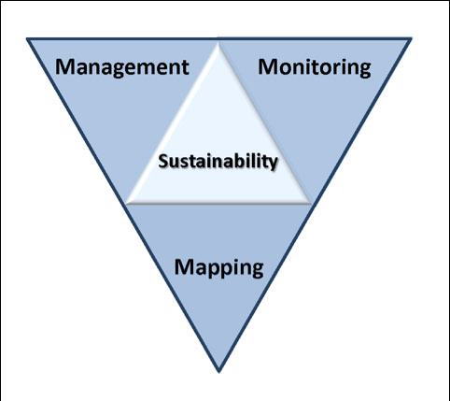
Six issues/Five Stakeholder Meetings
Topical areas
Wastewater*
Drinking water*
Groundwater
Sustainable Lakes
Water retention
Future state
* Short term
Notes:
Protection of ground water and surface water resources will require substantial investments from a diversity of funding sources over all levels of government during the next decade. As a part of this effort, this program of mapping, monitoring and managing is necessary to deliver the basic understanding of the hydrologic system for both surface and groundwater.

Slide 9
How can the recommendations be used?
Propose/promote/support legislation
Resource for stakeholders- legislative initiatives
Recommendations to guide or suggests programs/planning/funding:
LCCMR
CWC
Agencies/Governor’s Office

Slide 10
Discuss Issue of the Day
10

Slide 11
Resources:
Recommendation/issue summary paper-draft
Background issue paper- draft
Notes:
For more information and real time monitoring data you can visit this web site.

Slide 12
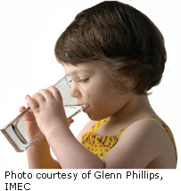
Drinking Water
Many Issues:
Significant infrastructure needs– small cities and towns
Source-water protection: SW/GW
Private Drinking Water Threats: nitrate, pesticides, chloride, lead, arsenic, radon, bacteria, viruses, pharmaceuticals, human-produced chemicals, emerging contaminants, toxic algae, spills
Non-sustainable use
Notes:
What we hope to leave you with is a much better understanding of our state’s groundwater resources and appreciation for the challenges we face.
Simply stated the problem we are increasingly recognizing is that there are ….

Slide 13
Recommendations: Drinking Water
Increase Source Water Programs
More monitoring- emerging contaminants
Increase investment DW infrastructure
Real-time monitoring of threats (rivers)
Address failing septic and storm water systems
Quantify failing waste/ storm water infrastructure
Implement GW protection rule
Increase utility hook-up fee
Legislation: required DW systems where wells/aquifers threatened
Embrace, fund new technology
Propose legislation -- Unused drug return requirement
Funding: Assess virus as threats to DW

Slide 14
Small Group Exercise
Discuss recommendations
What’s missing?
Who’s missing?
Rank (H,M,L)
Are they actionable- Move the needle?
Appropriate for Legislation/ Funding/Agency or Stakeholder Resource?
Consensus
Report back:
Top issues (1-2) and missing issue
40 minutes
Notes:
For more information and real time monitoring data you can visit this web site.

Slide 15
Next Steps
Revise Issue Statements
Revise Recommendations
Initial Consensus from LWC
Feedback from Stakeholders
Final consensus by LWC -November
Recommendations to Legislature
Legislative Briefings with Committees?

Slide 16
Clean Water Council
Notes:
What we hope to leave you with is a much better understanding of our state’s groundwater resources and appreciation for the challenges we face.
Simply stated the problem we are increasingly recognizing is that there are ….

Slide 17
Today’s Field Trip
NE Metro
Stromwater BMP’s
Drinking Water Treatment
Streamgage on Rice Creek
Hanson Park
Lunch
Back by 4:00 pm

Slide 18
2018 Meeting Schedule
Stakeholder meetings: July 18 (drinking water, groundwater); July 25 (wastewater, storm water); Aug. 8 (water retention); Aug 22 (lakes) and; August 29 (future state for MN waters). All at 1:00 pm (SOB)
August 20—LWC meeting and field tour—rural water management (9:00 am, site TBD) Yes?
Future LWC meetings: Discuss meeting times
Sept 17
October 15
November 12
December 10* (* Date change at Co-chair’s request)

Slide 19
Thanks!
Notes:
For more information and real time monitoring data you can visit this web site.

